Slide 1

Stock price prediction
By Team 4:
Sai Venkat Gunnapaneni
Kundana Janga
Bhargav Gurram

Slide 2
Contents
Introduction
Data description
Data collecting and pre-processing
Implementation
Model building and evaluation
Advantages and disadvantages of stock prediction in python
Challenge given
Conclusion and future scope
References

Slide 3
Introduction
The S&P 500 comprises 500 of the largest publicly traded companies in the United States and is commonly used by investors and analysts as a reference for the overall stock market. By accurately predicting the future performance of these stocks, investors can make well-informed decisions about their investments.

Slide 4
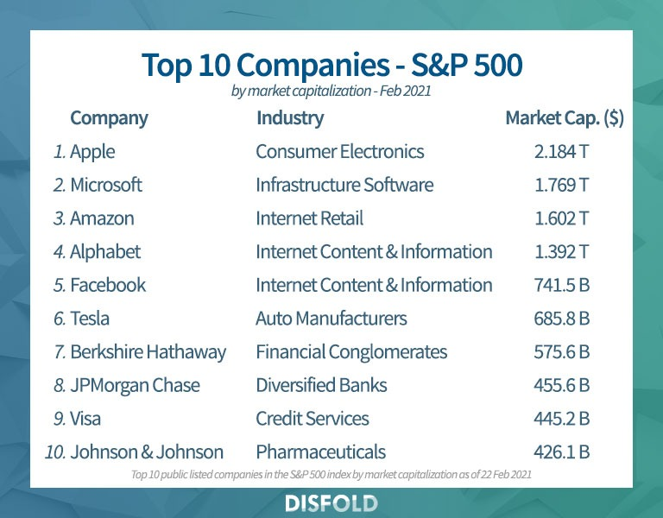
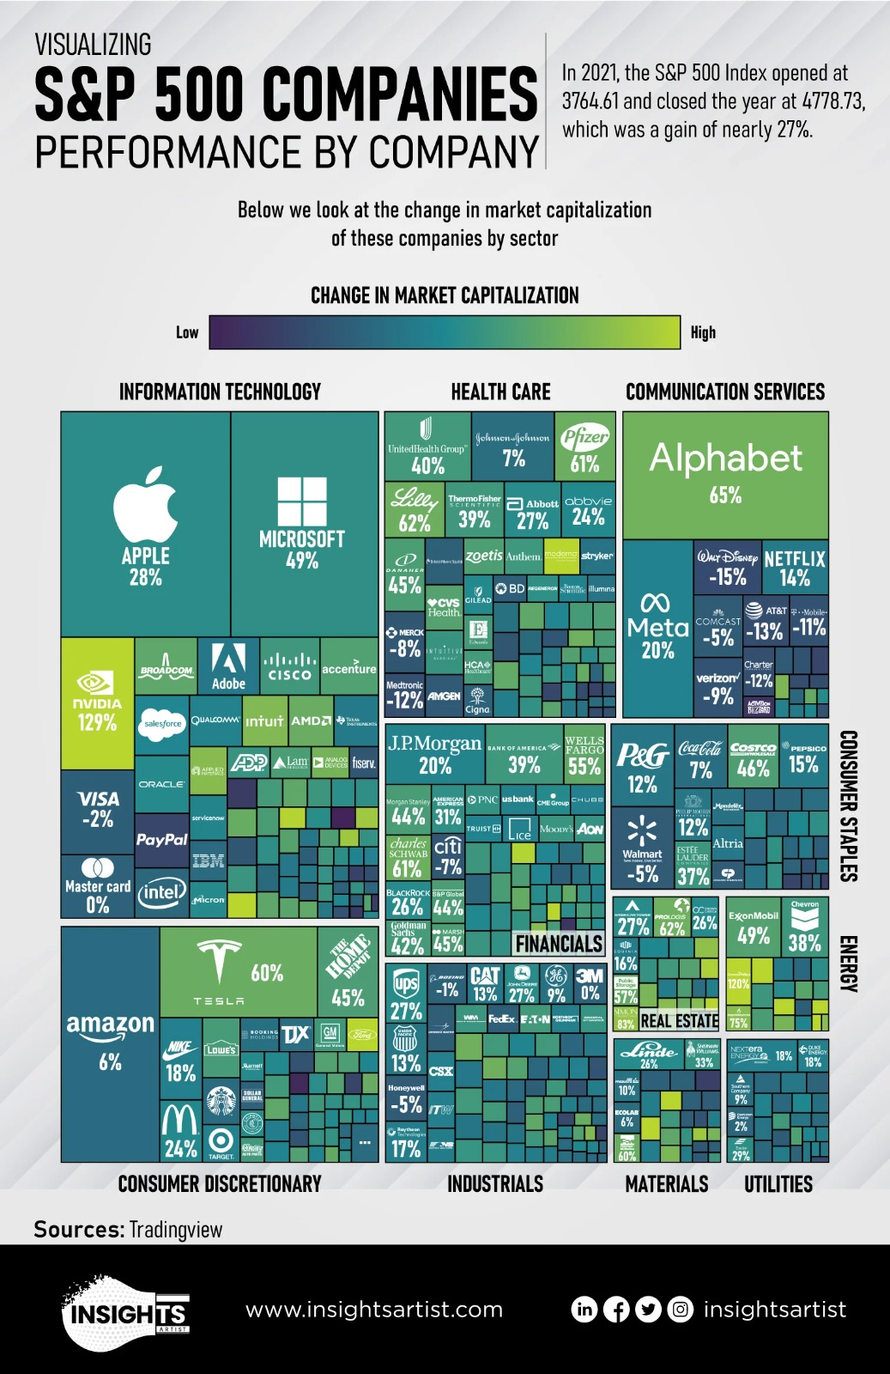

Slide 5
Data Description
The given dataset contains two sets of attributes:
Time intervals and their corresponding count:
DateTime: A time interval represented by the start and end dates.
Count: The number of data points in the given time interval.
Data values and their corresponding count:
Label: A range of data values represented by the start and end values.
Count: The number of data points falling within the given data value range.
Notes:
The data values appear to be numerical, ranging from 87.45 to 2476.83. It is unclear what the data represents, as there is no information on the context or domain of the data. However, it appears that the data may be related to some sort of measurement or observation of a numerical quantity over time. The time intervals are listed in chronological order, spanning from September 2, 1977 to August 29, 2017. There are 10 intervals of four years each, except for the last interval which is 4 years and 1 day. The counts vary between 39 and 632 for the data values and between 205 and 210 for the time intervals

Slide 6
Data collecting and pre-processing
Collect the S&P 500 stock data, including the columns "Date", "Open", "High", "Low", "Close", "Volume", "Dividends", and "Stock Splits".
Remove the columns "Dividends" and "Stock Splits" from the dataset as they are not needed for the analysis.
Create a new column "Tomorrow" by shifting the "Close" column one row down to represent the closing price of the next day.
Create a new column "Target" by comparing the "Tomorrow" and "Close" columns and converting the result into a binary variable where 1 indicates an increase in price and 0 indicates a decrease or no change in price.
Filter out the rows before January 1, 1990, using the pandas to_datetime function to convert the date string into a datetime object and the loc method to select the rows after that date.
Copy the filtered dataset into a new variable "sp500" for further analysis.

Slide 7
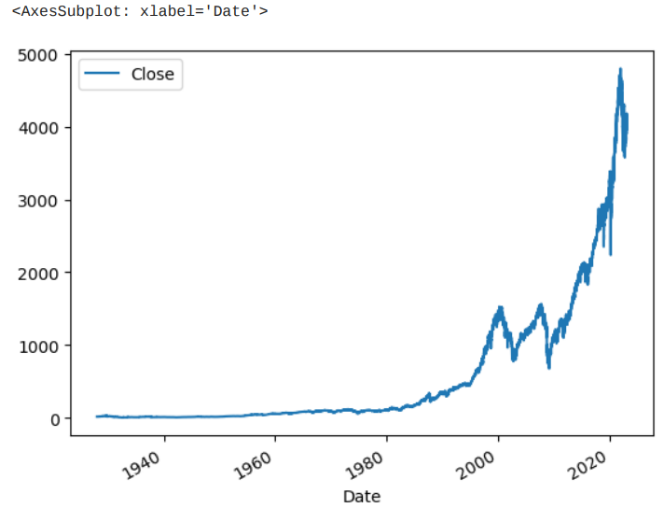

Slide 8
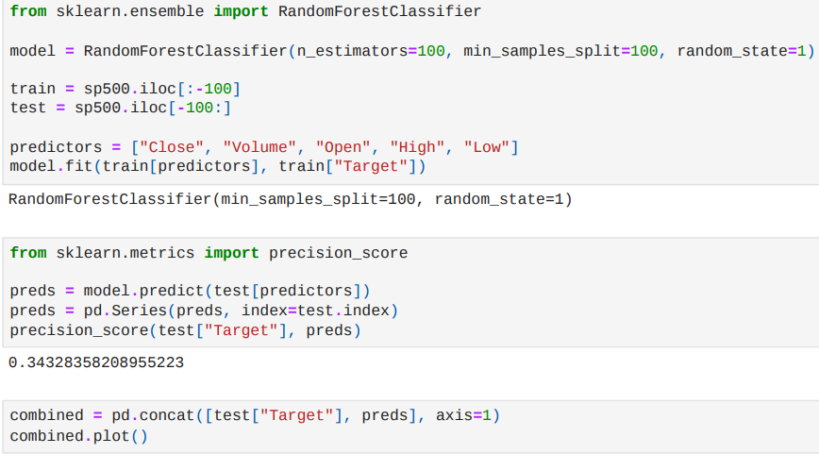
Implementation
This code trains a random forest classifier model using the RandomForestClassifier class from scikit-learn. The model is trained on the train dataset which consists of the S&P 500 historical stock prices up to the second to last 100 days. The last 100 days of the dataset is used as the test dataset.

Slide 9
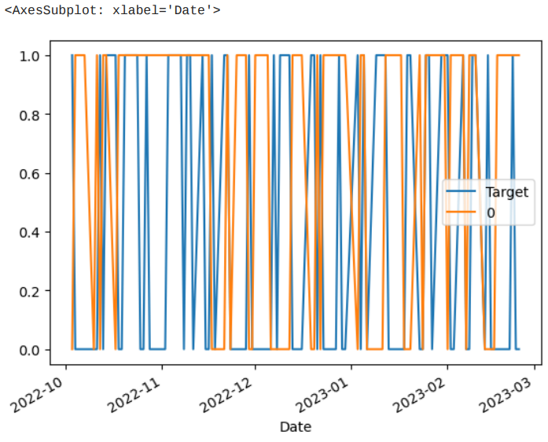
The precision_score function from scikit-learn is used to compute the precision score of the predictions. The precision score is a measure of the accuracy of the positive predictions made by the model, and it is computed as the ratio of true positives to the sum of true positives and false positives

Slide 10
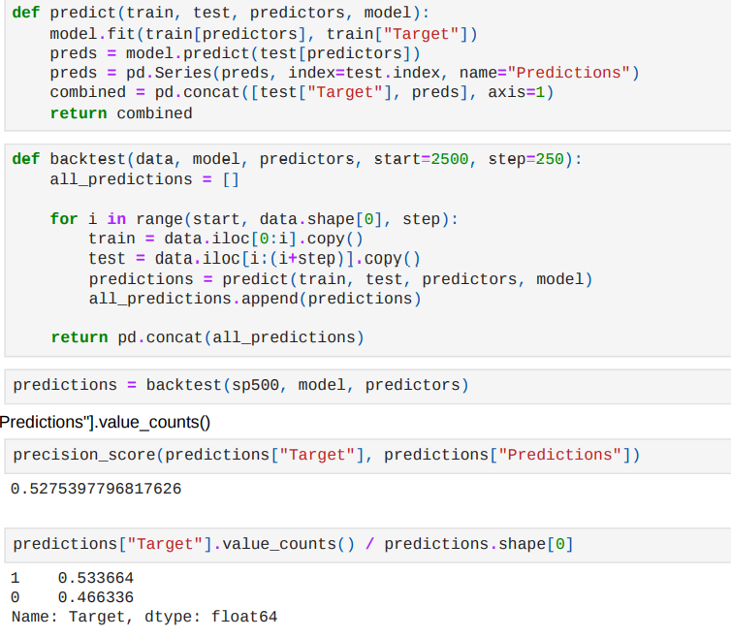
Model building and evaluation
In this code, we are creating some new predictors for our model using rolling averages and trend calculations.
ratio_column: This is the ratio of the current day's close price to the rolling average close price over the specified horizon.
trend_column: This is the sum of the target values (whether the price went up or down) over the specified horizon.
Finally, we are dropping any rows that have NaN values in any column except for the "Tomorrow" column.

Slide 11
Advantages and disadvantages of stock prediction in python
Python provides several benefits for stock prediction. It is a user-friendly and powerful language that allows for the development of complex models quickly. The language also has a vast community of developers that can offer support and guidance. Moreover, being open source, Python is free to use and can be customized to fit specific needs.
However, Python has some drawbacks when used for stock prediction. Its processing speed is slower than some other programming languages, which can cause delays in building models. Additionally, Python has fewer features compared to some other languages, which may limit the complexity of the models that can be constructed.

Slide 12
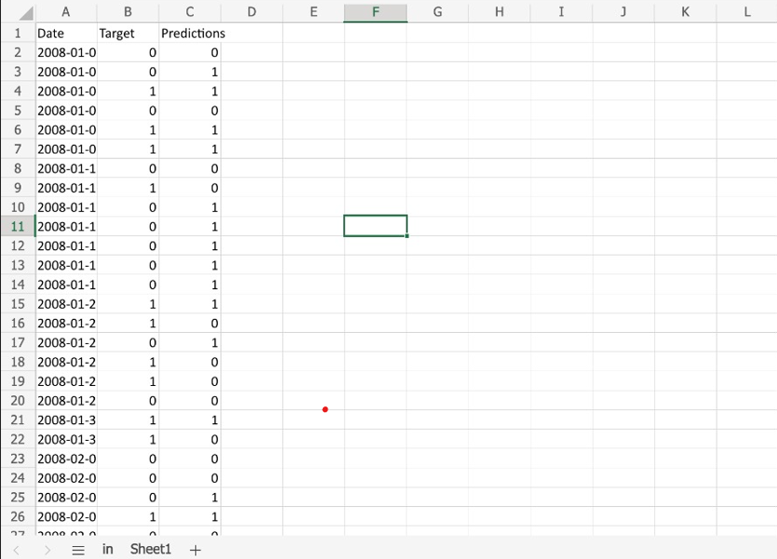
Challenges given: 2008 model

Slide 13
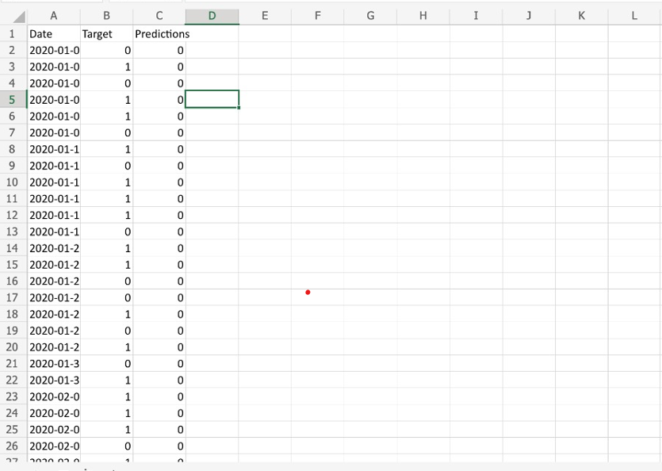
2020 model

Slide 14
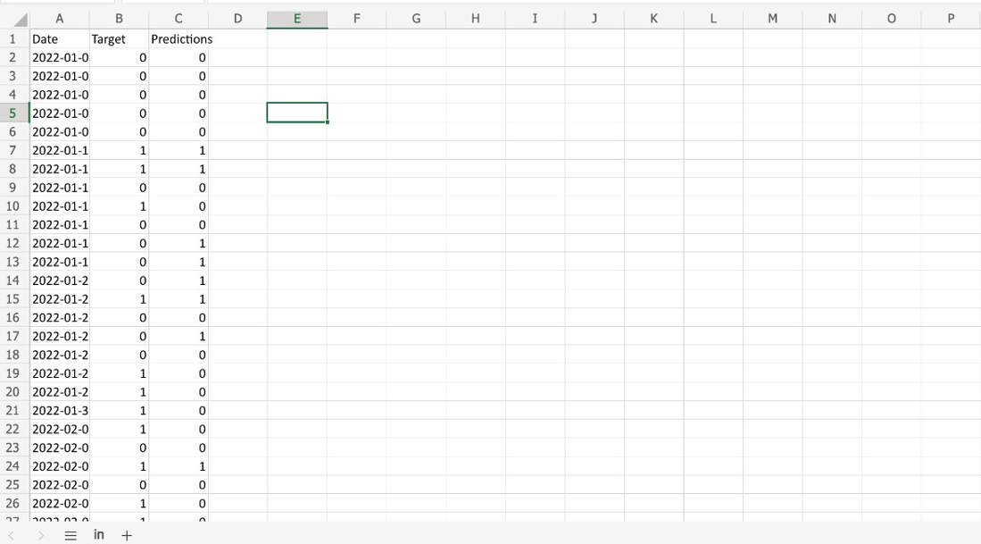
2022 model

Slide 15
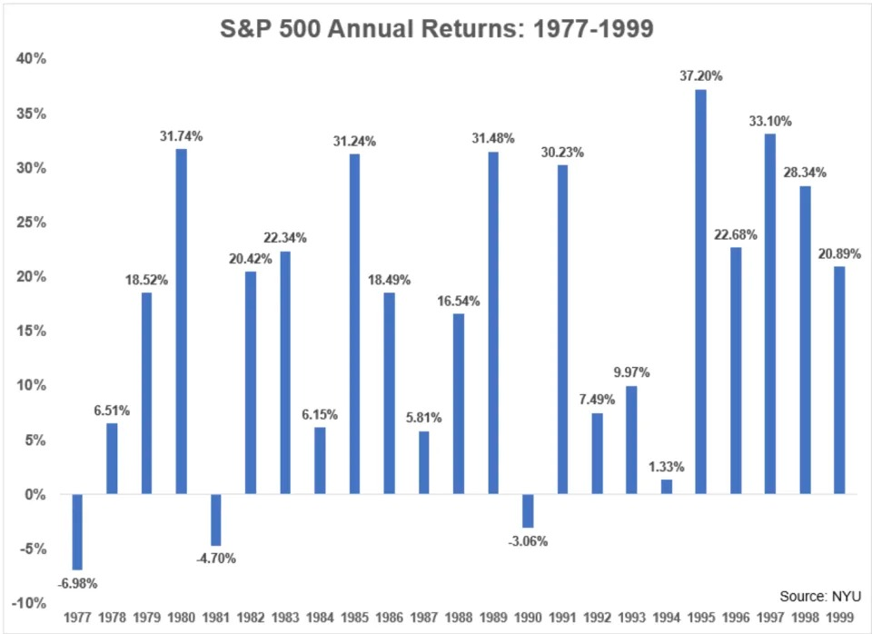
S&P 500 Annual Returns

Slide 16
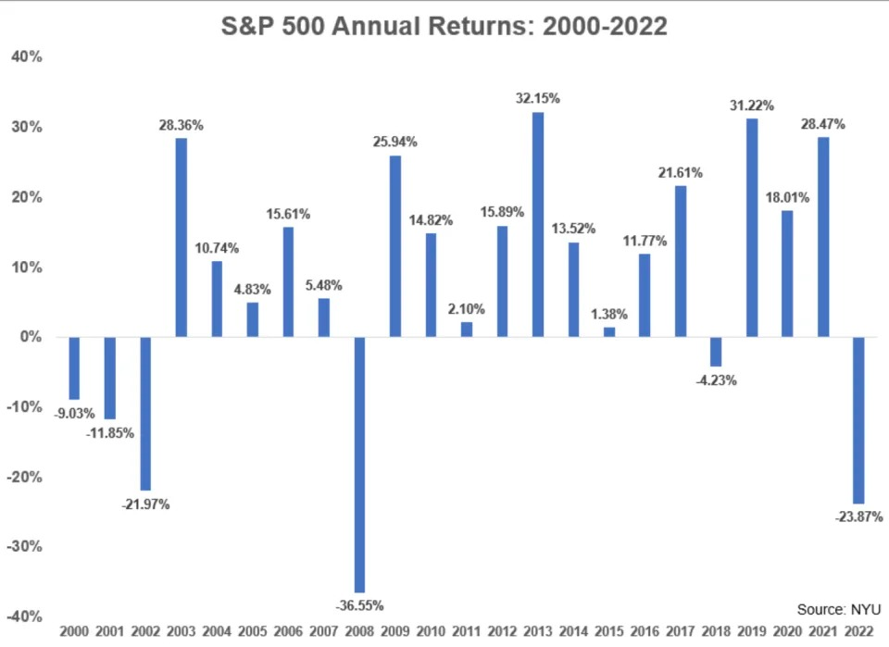

Slide 17
Conclusion and future scope
Forecasting stock market returns is challenging due to the multitude of factors that influence stock prices and the intricate patterns they create. The historical data provided on a company's website contains limited features, such as high, low, open, close, and adjusted close prices, as well as trading volume, which may not be adequate for precise predictions.
To enhance the precision of projected prices, additional variables can be generated from the current ones.
In future research, deep learning models that consider financial news articles in addition to financial parameters such as closing price, traded volume, profit and loss statements, could be developed for potentially better results.

Slide 18
References
[1] Masoud, Najeb MH. (2017) “The impact of stock market performance upon economic growth.” International Journal of Economics and Financial Issues 3 (4) : 788–798.
[2] Murkute, Amod, and Tanuja Sarode. (2015) “Forecasting market price of stock using artificial neural network.” International Journal of Computer Applications 124 (12) : 11-15.
[3] Hur, Jung, Manoj Raj, and Yohanes E. Riyanto. (2006) “Finance and trade: A cross-country empirical analysis on the impact of financial development and asset tangibility on international trade.” World Development 34 (10) : 1728-1741.
[4] Li, Lei, Yabin Wu, Yihang Ou, Qi Li, Yanquan Zhou, and Daoxin Chen. (2017) “Research on machine learning algorithms and feature extraction for time series.” IEEE 28th Annual International Symposium on Personal, Indoor, and Mobile Radio Communications (PIMRC): 1-5.
[5] Seber, George AF and Lee, Alan J. (2012) “Linear regression analysis.” John Wiley & Sons 329

Slide 19

THANK YOU
kundana.janga@slu.edu
saivenkatkumar.gunnapaneni@slu.edu
gurram.bhargav@slu.edu

